Slide 1

EEE ROBOFEST V.α 2022
Workshop on Advanced Robotics
CLUB ELECTRO

Slide 2

Instructor
Mir Sayeed Mohammad
Lecturer, CSE, BRAC University
B.Sc (Engg) EEE,
Bangladesh University of Engineering and Technology
Workshop on Advanced Robotics
Notes:
Session - 3

Slide 3
Workshop Contents
Introduction to Arduino
Working of motor and motor driver
Assembly of a line follower robot
Algorithm for robot
Coding
Workshop on Advanced Robotics
Notes:
Session - 3

Slide 4
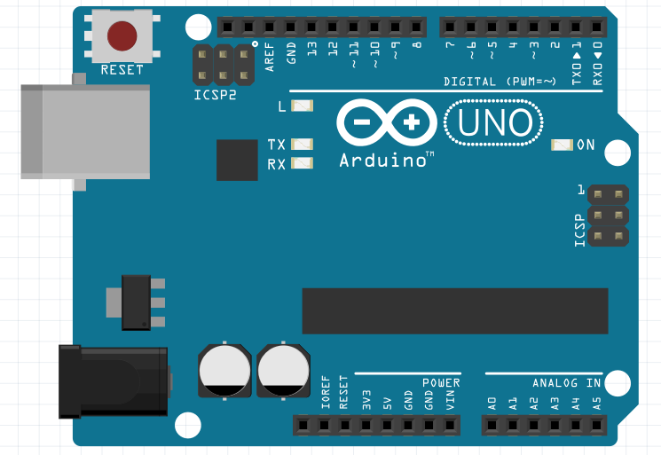
ARDUINO
THE BRAIN OF YOUR SYSTEM
Notes:
Session - 3

Slide 5






Powering up Your Arduino

Slide 6
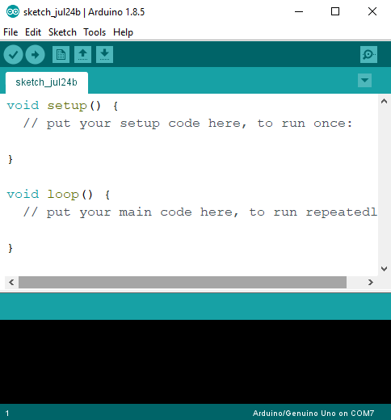
Programming the Arduino
The Arduino IDE
Arduino uses C++

Slide 7


Slide 8
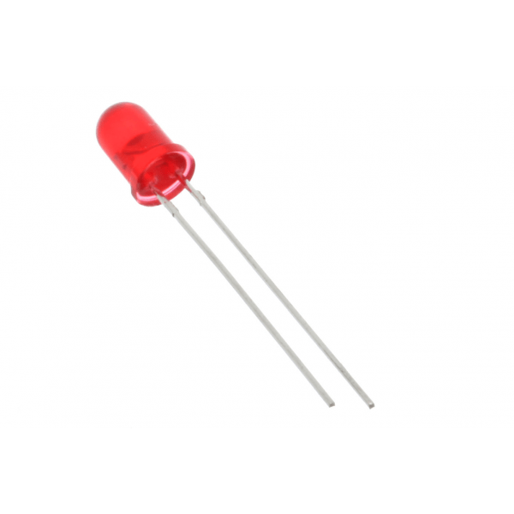
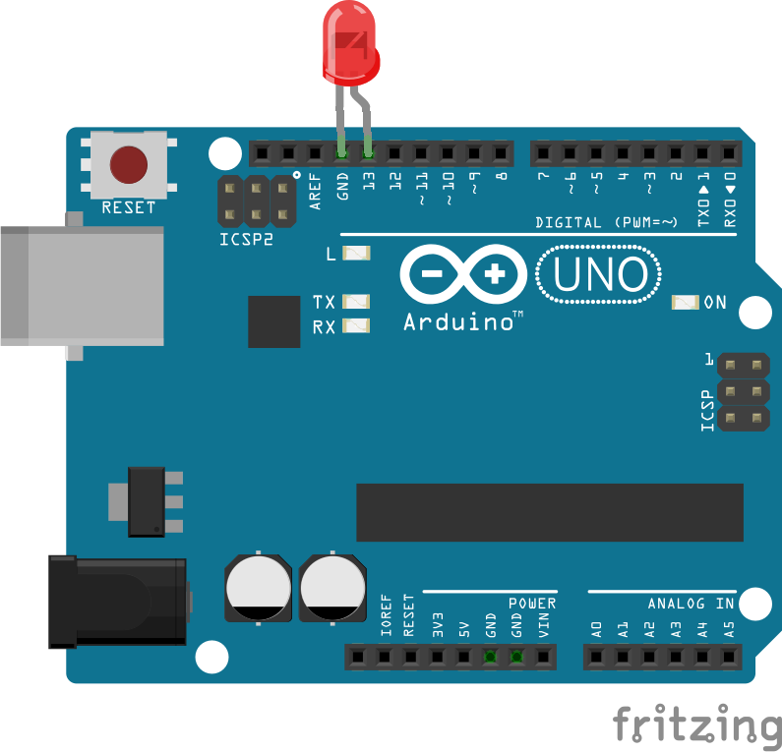
Blink
Long leg to Pin 13
Between
GND & Pin 13
Short leg to GND

Slide 9
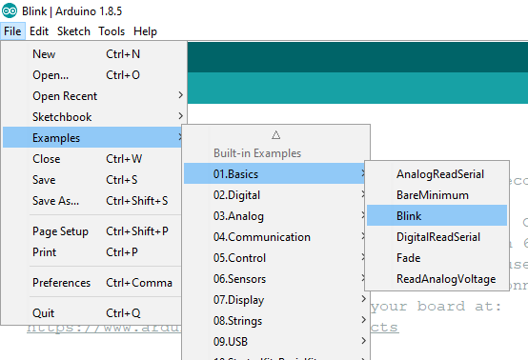
Find the Code
-> File
-> Examples
-> Basics
-> Blink

Slide 10
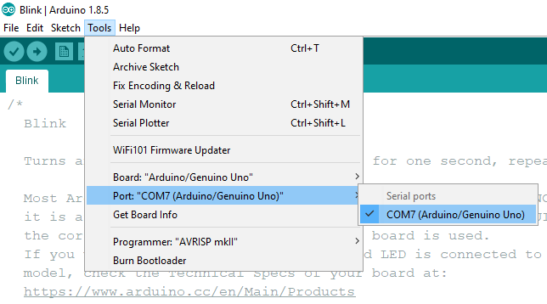
Remember to select port!
-> Tools
-> Port

Slide 11
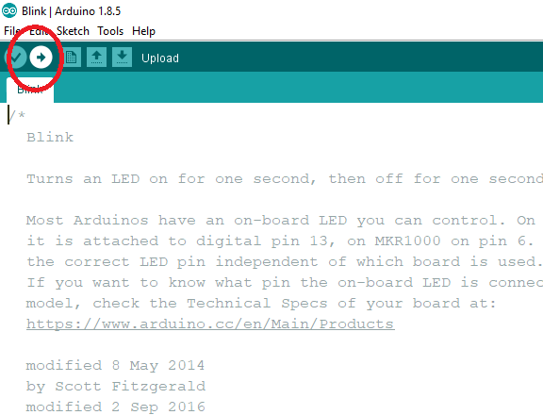
Hit Upload!!

Slide 12
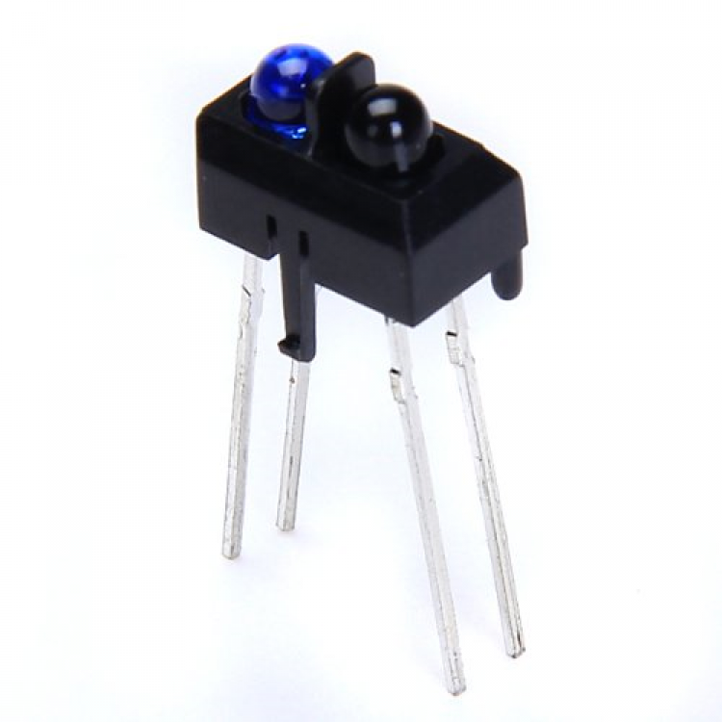
TCRT Sensor
THE EYES OF YOUR ROBOT
Notes:
Session - 3

Slide 13
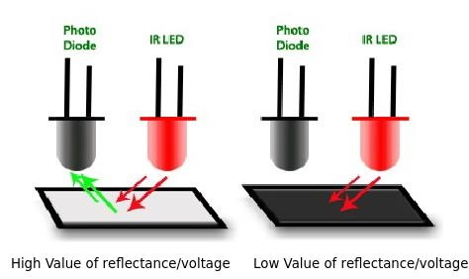
How Lines are Detected
Notes:
Session - 3

Slide 14
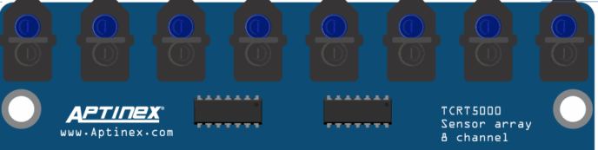
TCRT Array
Notes:
Session - 3

Slide 15
TCRT Array In Action
Line in Middle

Slide 16
TCRT Array In Action
Skewed Lines

Slide 17
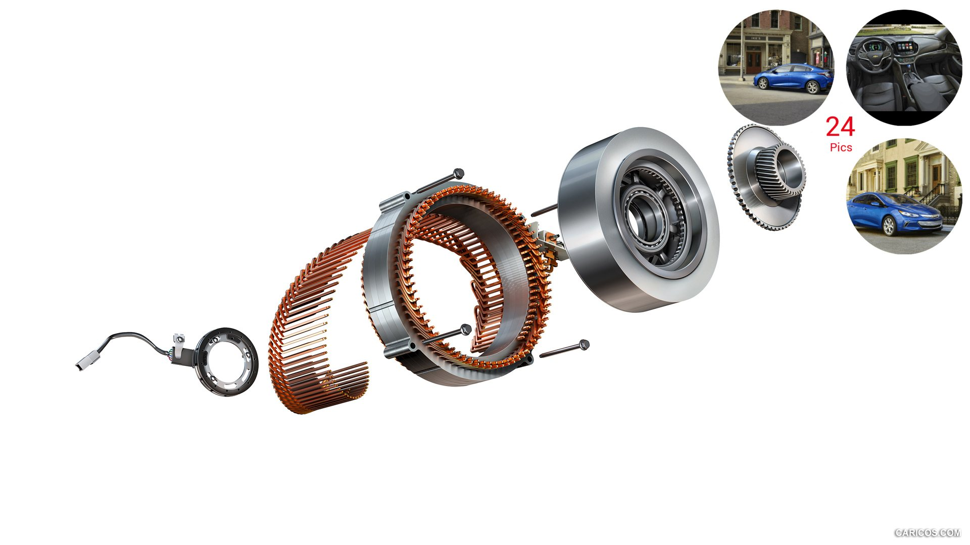

DC Motors
Muscles of a Robot

Slide 18
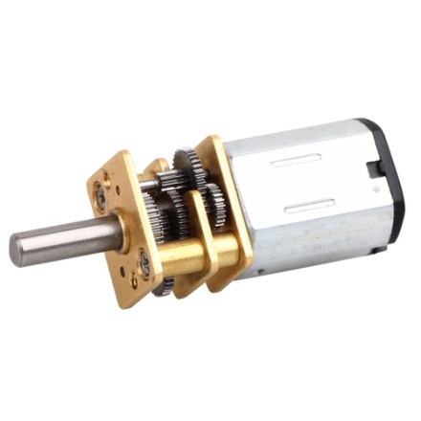
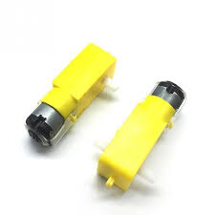
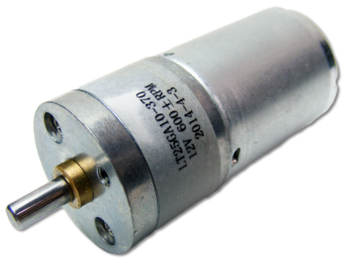
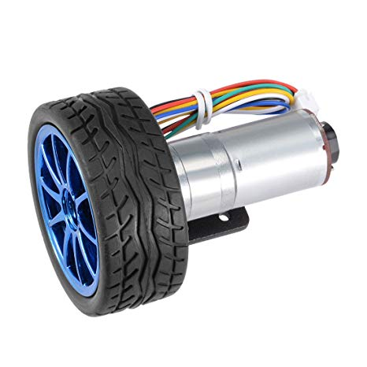
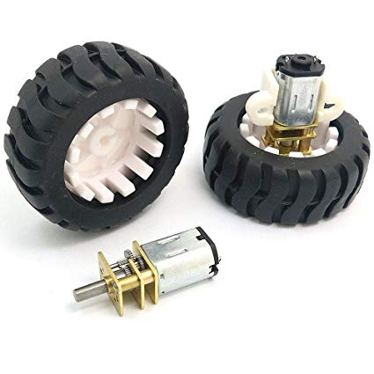
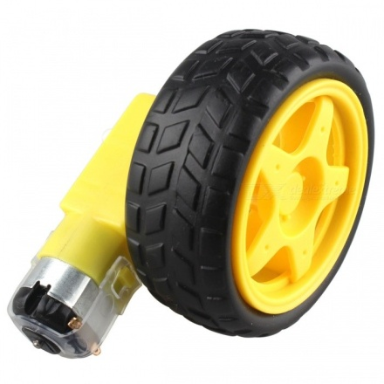
Common DC Motors and Wheels
High RPM
N20 Gear Motor
6V Dual Shaft

Slide 19

POWERING UP THE MOTOR

Slide 20
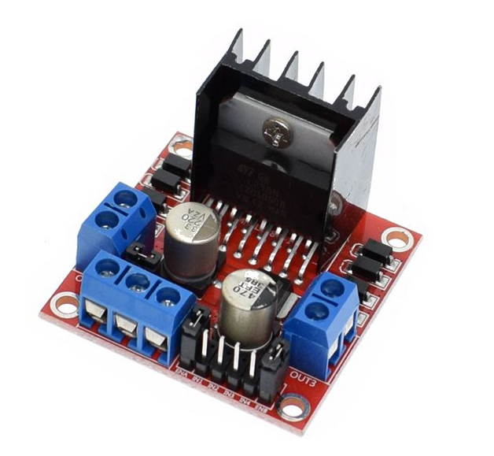
Add a Motor Driver !!

Slide 21
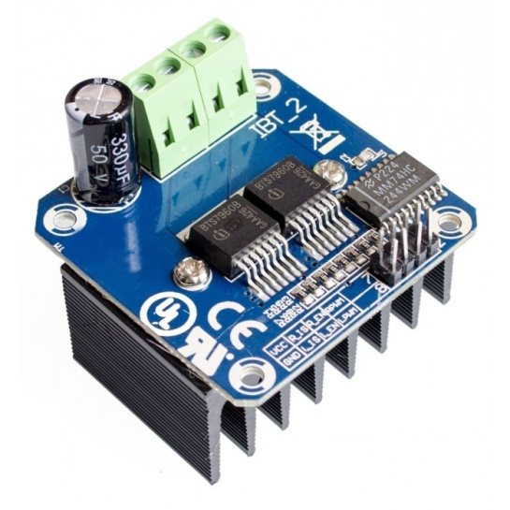
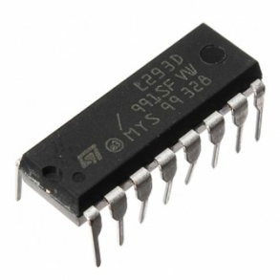
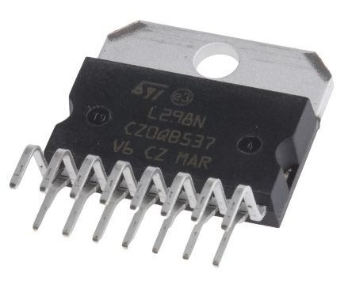
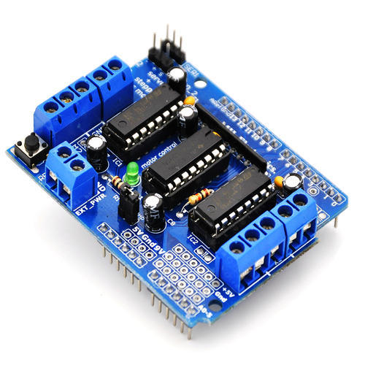

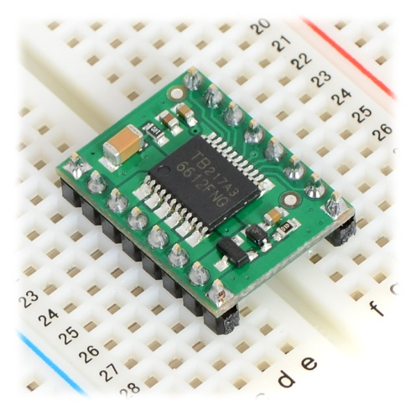
l293d
l298n
BTS7960
TB6612FNG

Slide 22
The H-Bridge
VCC
IN 1
IN 2
M
IN 2
IN 1
GND

Slide 23
The H-Bridge
VCC
IN 1
IN 2
M
IN 2
IN 1
GND

Slide 24
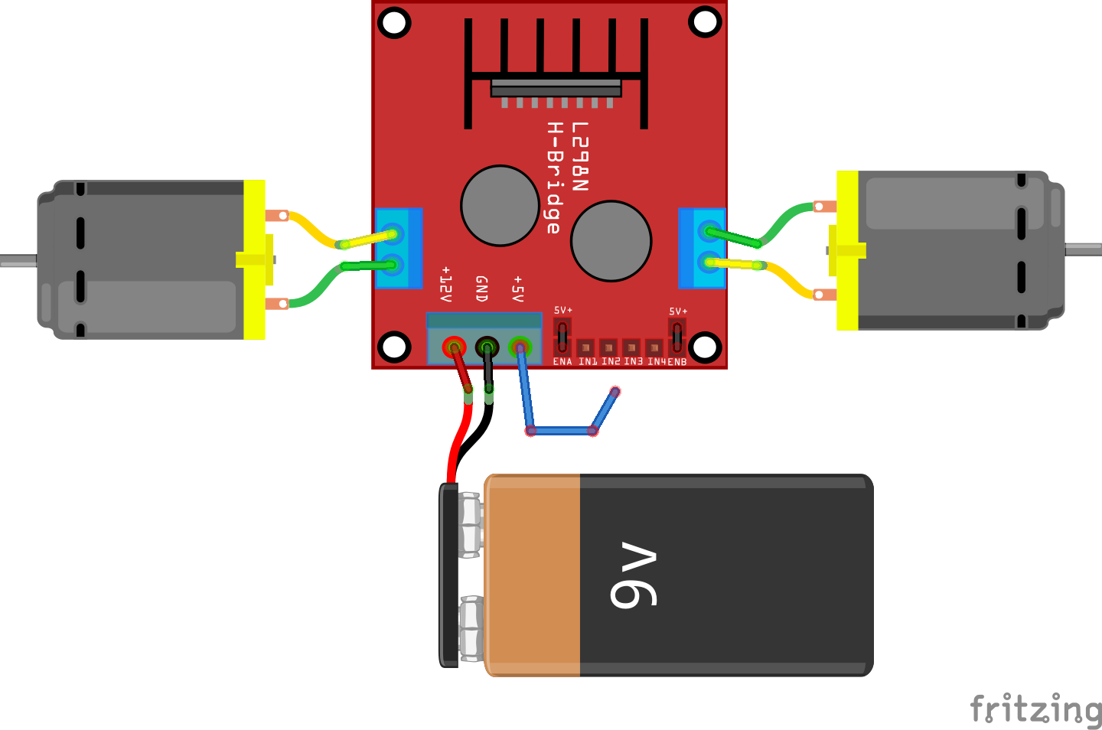
Working with the L298N

Slide 25
What is Happening Here?
M
M

Slide 26
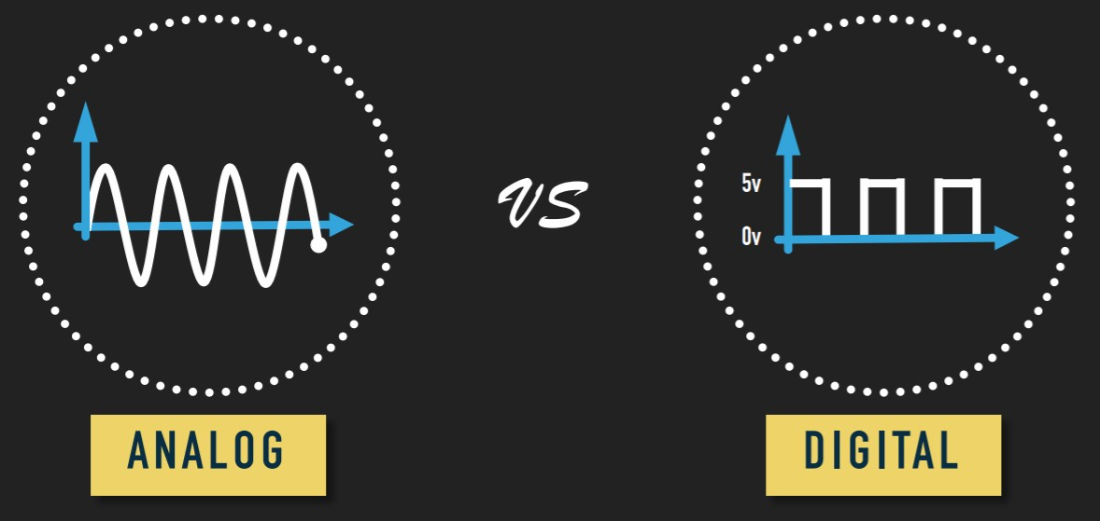
Analog VS. Digital

Slide 27
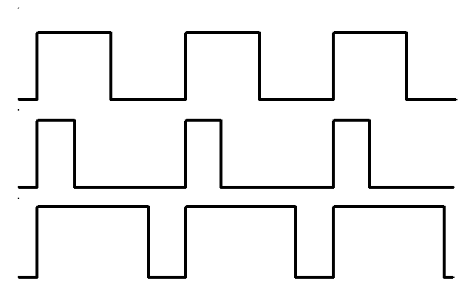
Pulse Width Modulation (PWM)
Duty cycle varies from 0-100%
Output is the time average of the function
PWM pins are marked in Arduino with ~ sign
Accessible through analogWrite(pin,value)
analogWrite takes values from 0(0%) to 255(100%)

Slide 28
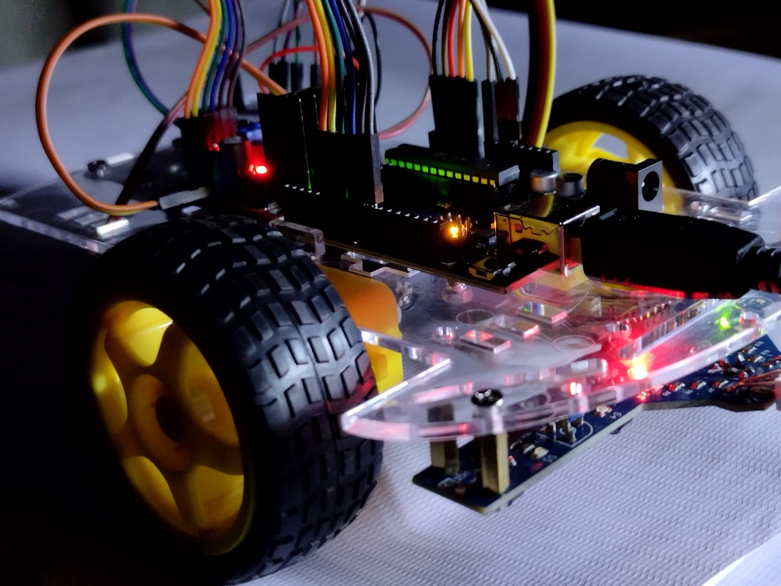
BUILDING THE ROBOT
Notes:
Session - 3

Slide 29
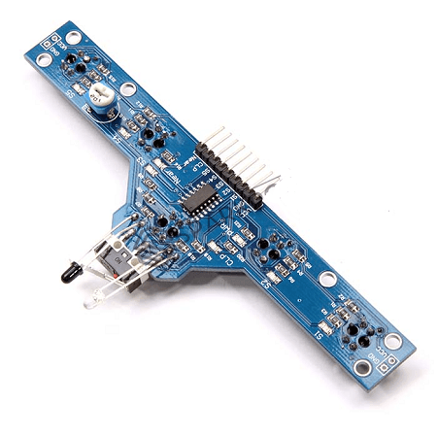
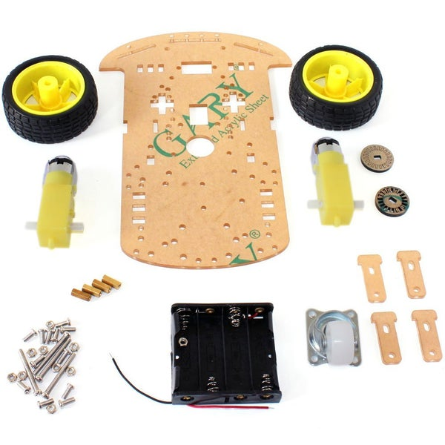
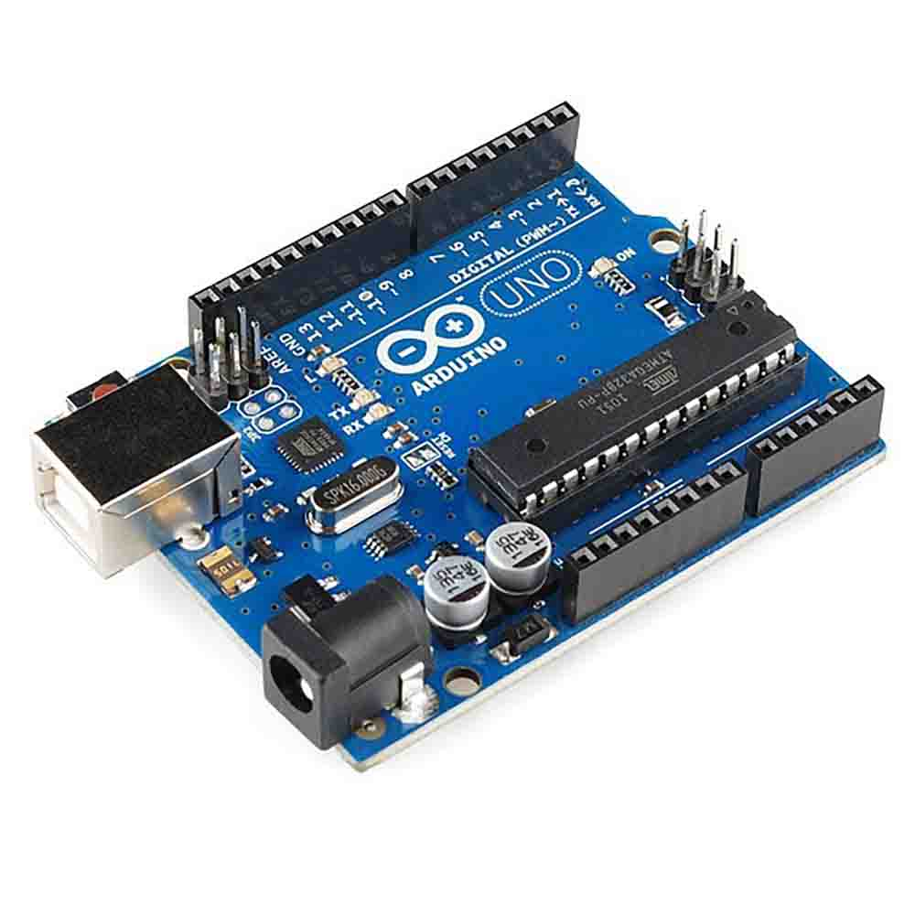

Slide 30
SOME THINGS TO REMEMBER
Notes:
Session - 3

Slide 31
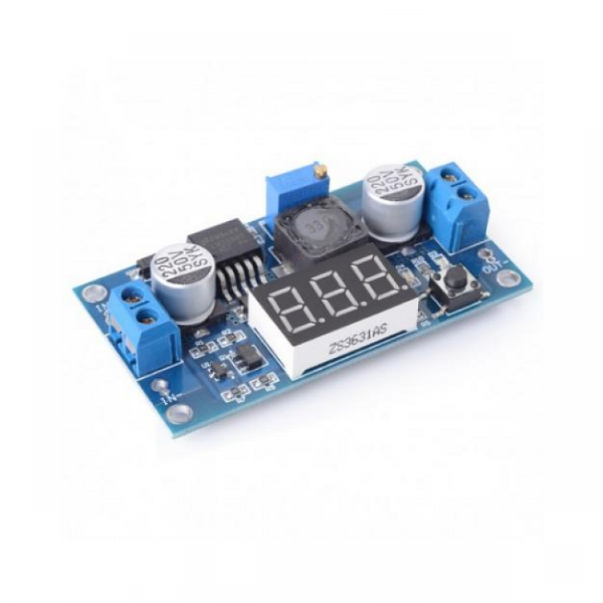
Power Source
Battery
Arduino
Buck Module
Notes:
Session - 3

Slide 32
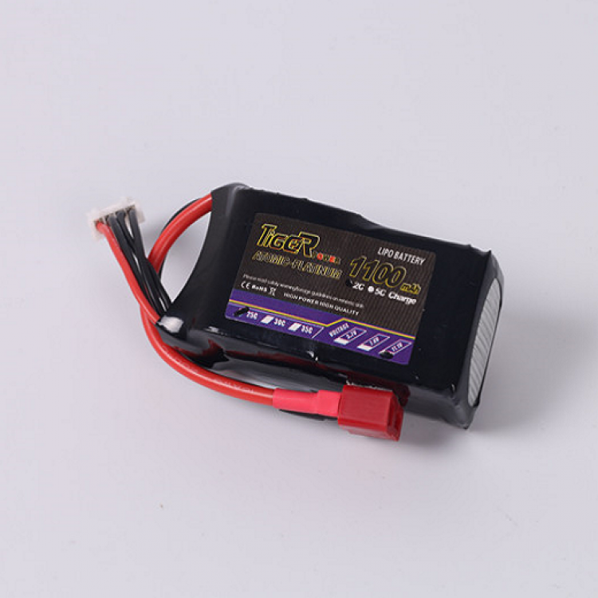
Battery
Lipo Battery
Notes:
Session - 3

Slide 33
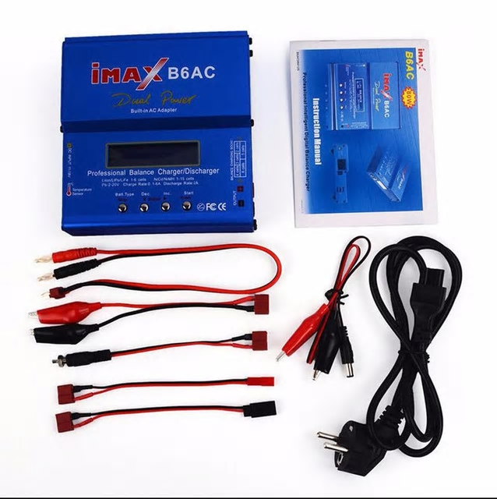
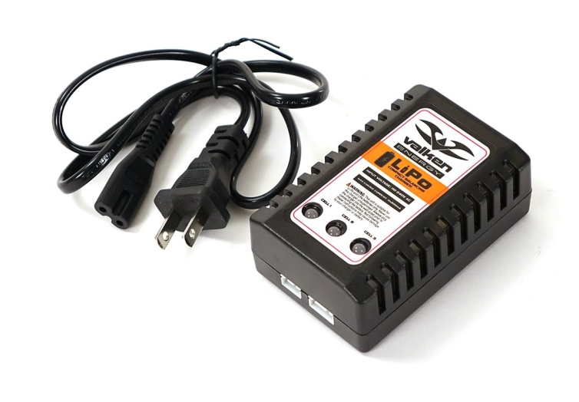
Charger
Notes:
Session - 3

Slide 34
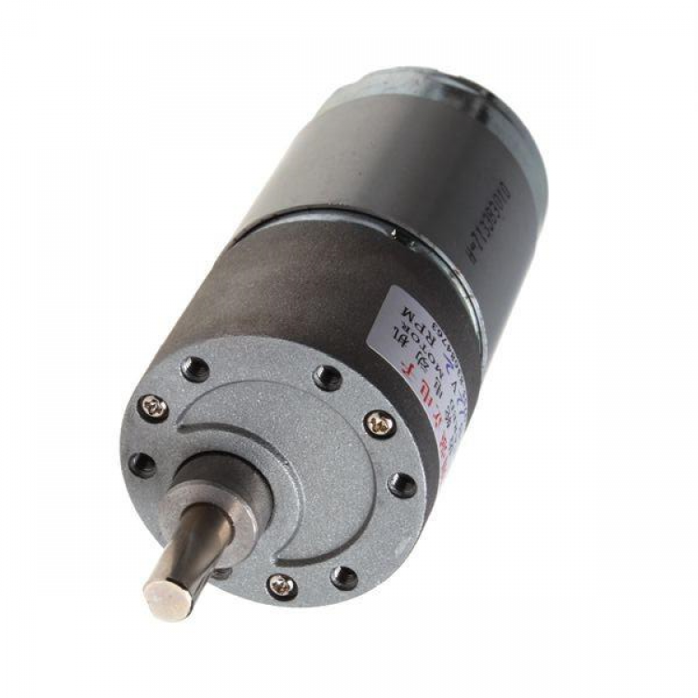
Better Motors
Notes:
Session - 3

Slide 35
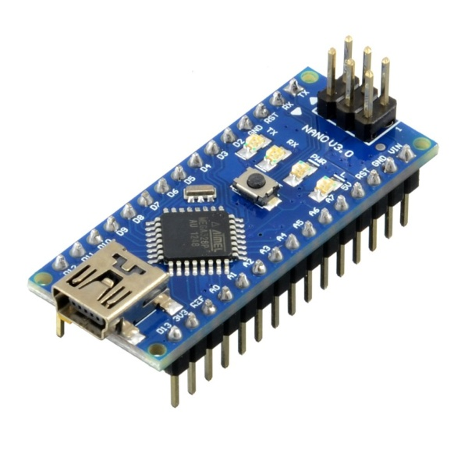
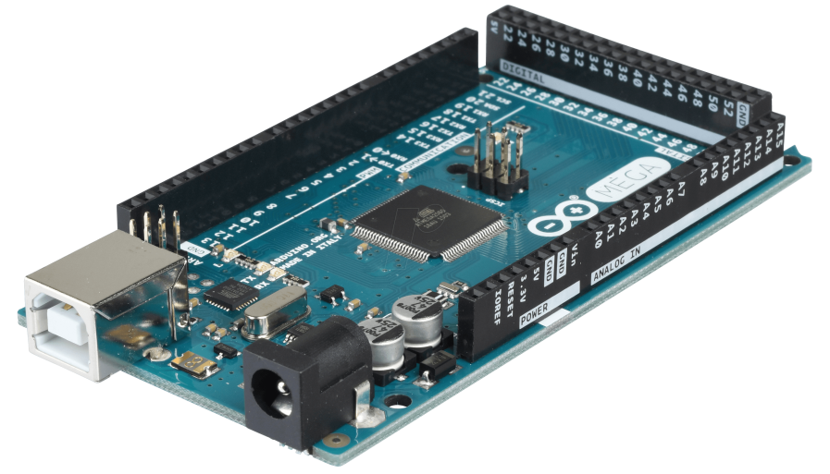
Microcontrollers
Arduino Mega
Arduino Nano
Notes:
Session - 3

Slide 36
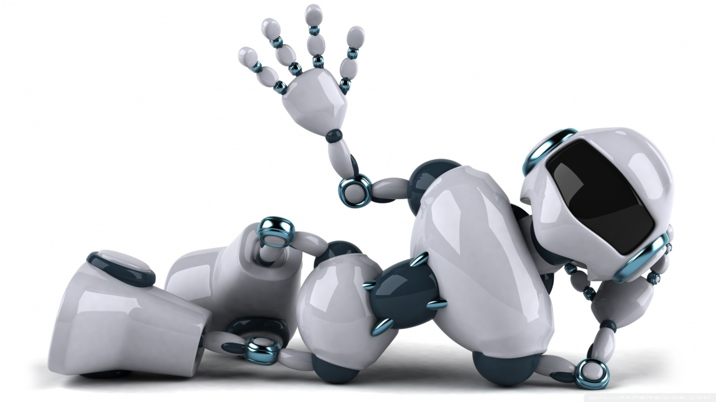
That’s all for today!!

